Slide 1


Samanta Jerin
4th Nov 2024

Slide 2

Outline
Executive Summary
Introduction
Methodology
Results
Conclusion
Appendix

Slide 3
Executive Summary
This capstone project predicts the likelihood of a successful Falcon 9 first-stage landing, leveraging SpaceX’s launch history data.
Summary of methodologies: Data was collected through the SpaceX REST API and web scraping, followed by data wrangling, analysis, and exploratory visualization. Key methodologies include SQL, data visualization, and machine learning.
Summary of all results: The project developed and evaluated several machine learning models, concluding that the Decision Tree model offers the most effective predictive accuracy. This work provides insights for understanding landing success factors, enhancing predictions with data-driven machine learning strategies.​

Slide 4
Introduction
Project background and context: This project investigates the cost efficiency of SpaceX’s Falcon 9 rocket, which achieves substantial savings through first-stage reusability, reducing launch costs to $62 million compared to competitors' $165 million.
Problems you want to find answers: The goal is to predict successful first-stage landings using a machine learning pipeline, which could inform competitive bids in the space launch market. Analysis will explore patterns in SpaceX launch data, factors affecting success rates, and the predictability of outcomes based on historical data.​

Slide 5

Section 1

Slide 6
Methodology
Executive Summary
Data collection methodology:
Employed SpaceX REST API and web scraping to obtain Falcon 9 mission data..​
Perform data wrangling
Conducted data wrangling, focusing on Falcon 9 data and converting outcomes into training labels
Perform exploratory data analysis (EDA) using visualization and SQL:
Utilized SQL and visualization tools for initial data analysis.​
Perform interactive visual analytics using Folium and Plotly Dash:
Created interactive visual analytics with Folium and Plotly Dash to examine launch sites, orbits, payloads, and mission outcomes.​
Perform predictive analysis using classification models
Standardized data and split into training and testing sets.​
Applied classification models, with hyperparameter tuning to enhance accuracy, producing a pipeline to predict first-stage landing success.

Slide 7
Data Collection
SpaceX API: Used to gather data on Booster Version, Launch Site, Payload Mass, and Core.​
Endpoint URL: https://api.spacexdata.com/v4/launches/past​
Data accessed via a GET request, returned in JSON format, and converted to a Pandas DataFrame with .json_normalize().​
Web Scraping: Collected additional data, including Flight Number, Date & Time, Booster Version & Landing, Launch Site, Payload, and Orbit Destination.​

Slide 8
Data Collection-Flow chart
Requesting data set from SpaceX API
Response= requests.get(spacex_url)
Response content decoding using .json() then turning into a dataframe using .json_normalise()
Send a request for information on Lunches using custom functions
Construct data into dictionary
Replacing missing values of Payload Mass column iwith calculated mean() fo r this column
Filtering dataframe and include only Falcon9 lunches
Create data frame form the dictionary
Exporting data to CSV
Git Repository: https://github.com/Arony09/SpaceX-Falcon-9-first-stage-Landing-Prediction/blob/main/jupyter-labs-spacex-data-collection-api.ipynb

Slide 9
Data Collection – Web Scraping
Data Source: Wikipedia table for Falcon 9 launches.​
URL: https://en.wikipedia.org/w/index.php?title=List_of_Falcon_9_and_Falcon_Heavy_launches&oldid=1027686922​
Used requests.get() to fetch HTML content.​
Created a BeautifulSoup object for parsing
Populated an empty dictionary with these headers, converting it to a Pandas DataFrame for analysis.​
Extracted relevant column headers from the table header
Exporting the data to CSV
Git Repository: https://github.com/Arony09/SpaceX-Falcon-9-first-stage-Landing-Prediction/blob/main/jupyter-labs-spacex-data-collection-api.ipynb

Slide 10
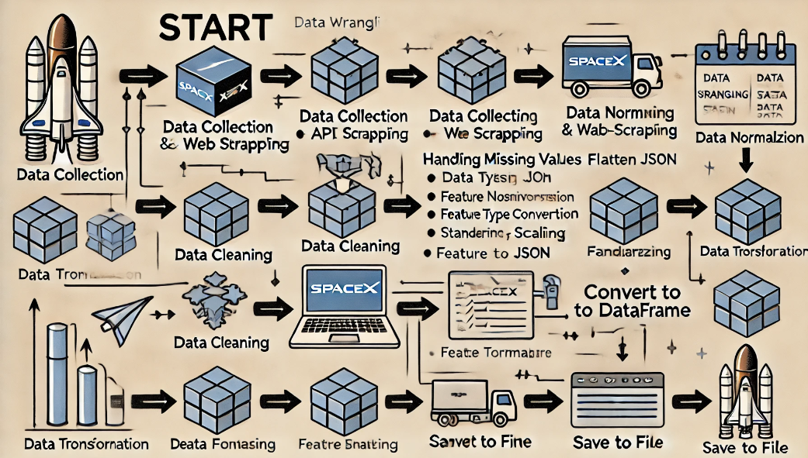
Data Wrangling
The data wrangling process began with data collection, using the SpaceX API to gather specific fields (e.g., Booster Version, Launch Site, Payload Mass) and supplementing it with additional data through web scraping (e.g., Flight Number, Date & Time). Next, data cleaning was performed, which included handling missing values, converting data types, and standardizing formats. The JSON data was then normalized using json_normalize() for a flat structure, and any necessary scaling or transformations were applied. Feature engineering was used to create new, insightful variables, and the API and scraped data were merged into a single dataset. Finally, the data was loaded into a Pandas DataFrame, cleaned, and stored in a suitable format for predictive modeling and analysis.
Git Repository: https://github.com/Arony09/DATA-WRANGLING-LAB/blob/main/labs-jupyter-spacex-Data%20wrangling%20(1).ipynb

Slide 11
EDA with Data Visualization
Tools Used:
Seaborn: Explored feature relationships with scatter plots for:​
Flight Number vs. Launch Site​
Payload Mass vs. Launch Site​
Flight Number vs. Orbit Type​
Payload Mass vs. Orbit Type​
Matplotlib: Visualized data trends using:​
Bar Charts for comparing success rates across orbit types.​
Line Charts for observing yearly trends in launch successes.​
Key Visualizations:
Scatter Chart: Shows feature correlations.​
Bar Chart: Illustrates success rate comparisons by orbit.​
Line Chart: Displays the annual trend in launch outcomes.​
Git Repository: https://github.com/Arony09/Exploring-and-Preparing-Data

Slide 12
EDA with SQL
Key Queries​
DISTINCT: Retrieve unique launch site names.​
SUM(), AVG(): Calculate total and average payload mass for specific boosters (e.g., NASA(CRS) and F9 v1.1).​
COUNT(): Determine the number of successful and failed missions.​
GROUP BY: Categorize records by factors like launch sites.​
ORDER BY DESC: Sort successful landings in descending order between 04-06-2010 and 20-03-2017.​
Specific Data Extracted:
Launch sites starting with "CCA"​
Records of successful drone ship landings with payloads between 4000-6000 kg​
First successful ground landing date​
Booster versions with maximum payload​
Git Repository: https://github.com/Arony09/Exploring-and-Preparing-Data

Slide 13
Build an Interactive Map with Folium
Launch Site Visualization:
Created markers and circles to represent all launch sites, highlighting their national distribution.​
Each site features a cluster of markers indicating successful and failed launch locations, providing insights into the success rates at each site.​
Distance Analysis:​
Drew two lines from each launch site:​
One line to the nearest coastline marker.​
A second line to a major highway intersection.​
This visual representation illustrates the distance from launch sites to hazardous areas, such as rocket launch activities.​
Map Features:​
Circle Object: Added highlighted circles at specific coordinates with descriptive popups using folium.Popup().​
Marker Object: Utilized markers to signify important elements on the map, functioning as signposts for user navigation.​
MousePosition Object: Enabled coordinate retrieval for user interaction when hovering over specific points on the map.​
PolyLine Object: Implemented lines connecting launch sites to selected points for better spatial understanding.​
This interactive mapping project enhances the visualization and analysis of launch site data, facilitating informed decision-making regarding safety and operational efficiency.​
Git Repository: https://github.com/Arony09/Interactive-Visual-Analytics-with-Folium

Slide 14
Build a Dashboard with Plotly Dash
Dashboard Overview​
Developed an interactive dashboard that allows users to select different launch sites and payload masses, providing a comprehensive view of launch data.​
Key Visualizations:​
Pie Chart:​
Displays the number of launches per site.​
Dynamically updates to show the success rate based on the selected launch site from the dropdown list.​
Scatter Plot:​
Visualizes the relationship between payload mass and booster usage.​
Updates in real time as users adjust the payload range using a slider.​
User Interaction Components:​
Dropdown List:​
Enables users to choose specific launch sites or view data for all sites combined.​
Affects the pie chart to display success rates pertinent to the selected site.​
Range Slider:​
Allows users to define a payload mass range.​
Interacts with the scatter plot to filter data on booster landings based on the selected payload range, categorized by booster versions.​
This Plotly Dash dashboard offers a user-friendly interface for analyzing launch data, facilitating insights into launch success rates and booster performance relative to payload masses.​

Slide 15
Predictive Analysis (Classification)
Data Preparation:​
Created an array using NumPy from the "Class" column in the data frame to define the target variable.​
Standardized and transformed features for prediction, assigning them to variable.​
Data Splitting:​
Utilized train test_split() to divide the data into training and test sets, using a test size of 20% (0.2) and a random state of 2, resulting in 18 test samples.​
Model Evaluation:​
Evaluated multiple classification algorithms:​
Logistic Regression​
Support Vector Machine (SVM)​
K-Nearest Neighbors (KNN)​
Decision Trees​
Computed accuracy scores and confusion matrices for each model to identify the best performer.​
Hyperparameter Optimization:​
Created a GridSearchCV object for each model to tune hyperparameters.​
Fitted models using parameter grids in dictionary format to determine the optimal hyperparameters.​
Retrieved the best parameters using the best_params_ attribute.​
Performance Assessment:​
Identified the best-performing model by analyzing the best_score_ attribute for accuracy.​
Visualized the model's performance on the test dataset using confusion matrices.​
This predictive analysis framework leverages various classification algorithms to ascertain the most effective model for classification tasks, enhancing predictive capabilities through rigorous evaluation and optimization of model parameters.​
Git Repository: https://github.com/Arony09/Space-X-Falcon-9-First-StageLandingPredictSpace-X-FalconComplete-the-Machine-Learning-Prediction-lab/blob/main/SpaceX_Machine%20Learning%20Prediction_Part_5.ipynb

Slide 16
Results
Exploratory data analysis results
Interactive analytics demo in screenshots
Predictive analysis results

Slide 17

Section 2

Slide 18
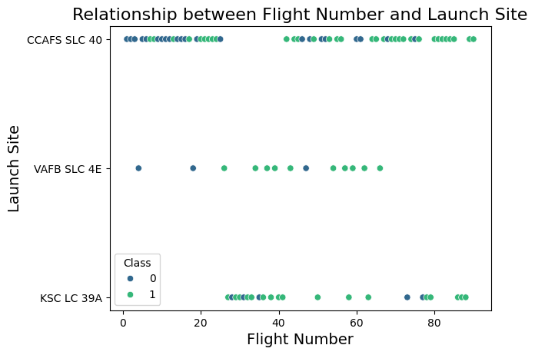
Flight Number vs. Launch Site
CCAFS SLC 40 lunch site shows significantly higher lunches compared to other sites.​

Slide 19
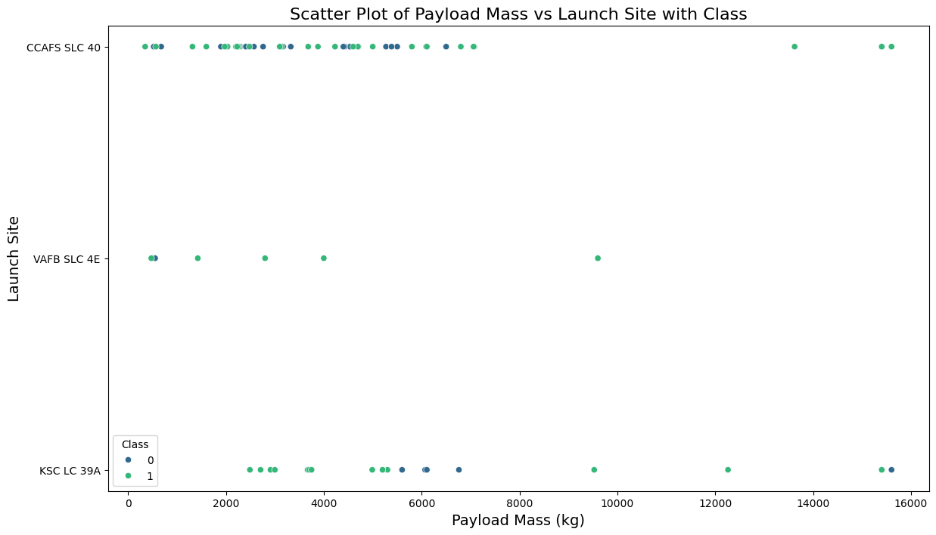
Payload vs. Launch Site
There are significantly higher number of lunch site in CCAFS SLC 40 sites with lower Pay Load Mass(KG)

Slide 20
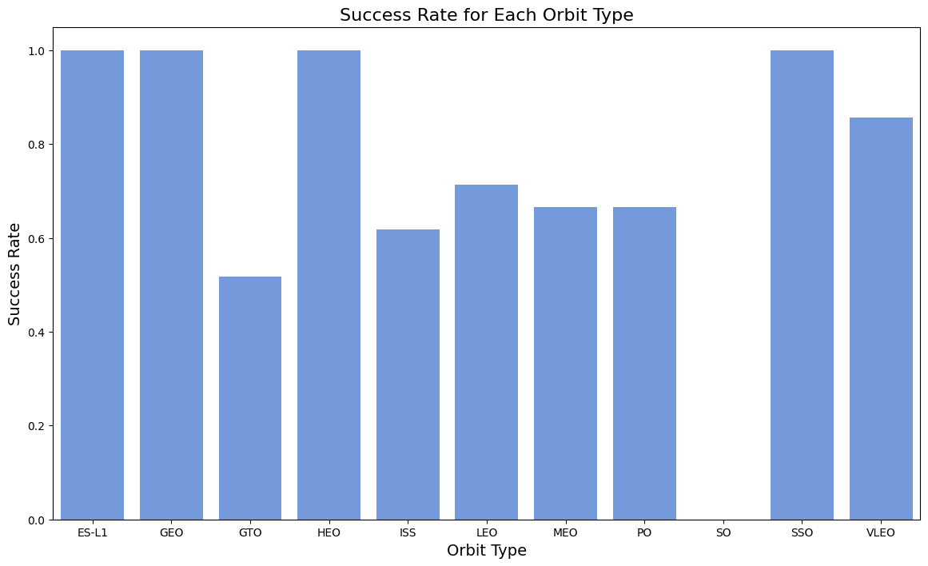
Success Rate vs. Orbit Type
ES-L-1, GEO, HEO ,SSO and VLEO orbits show the highest success rate.​

Slide 21
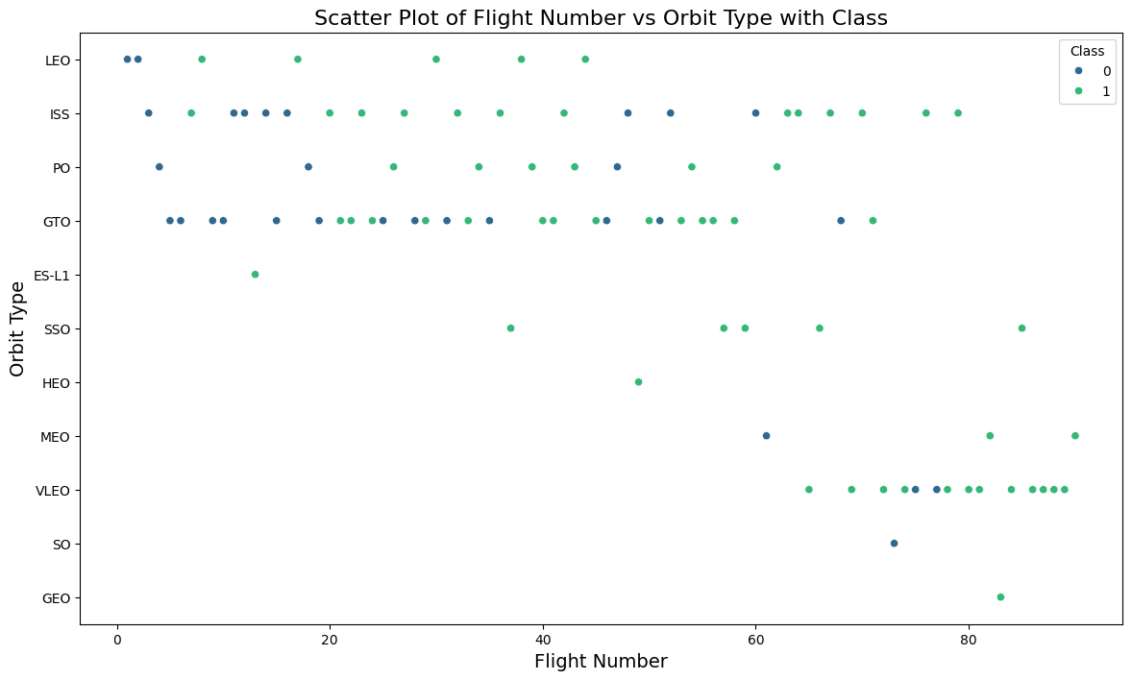
Flight Number vs. Orbit Type
There is a trend of shifting to VLEO lunches in recent years.

Slide 22
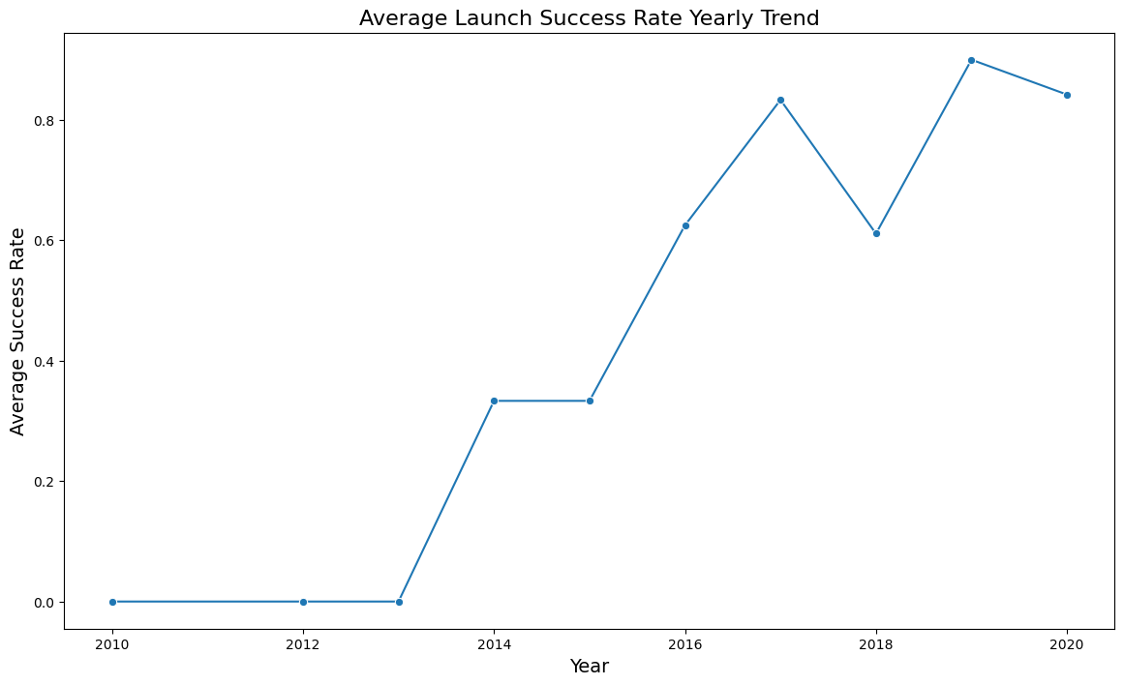
Launch Success Yearly Trend
Success rate for lunching has increase significantly between 2023-2020

Slide 23
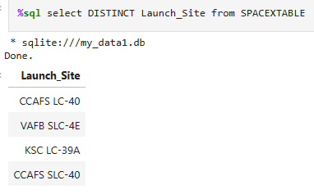
All Launch Site Names

Slide 24
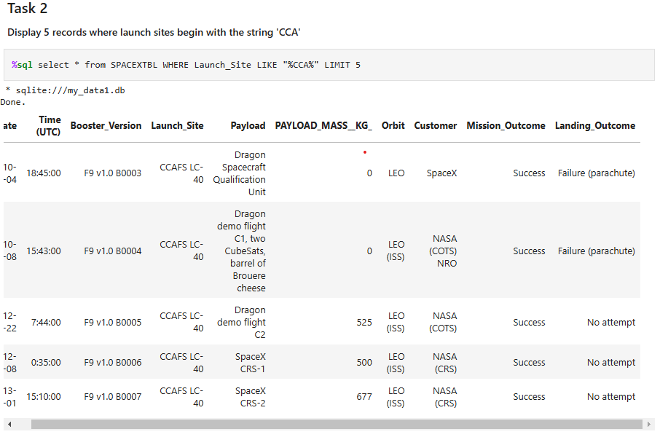
Launch Site Names Begin with 'CCA'

Slide 25
Total Payload Mass
total_payload_mass​
45596​

Slide 26
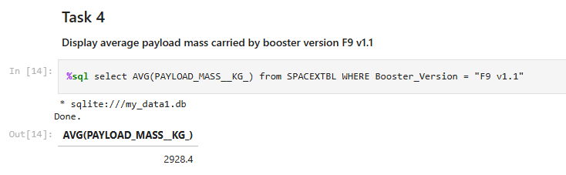
Average Payload Mass by F9 v1.1
The average payload mass carried by booster version F9v1.1 is 2928.4

Slide 27
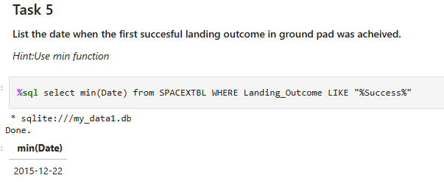
First Successful Ground Landing Date
The first successful ground landing occurred on 22 December 2015

Slide 28
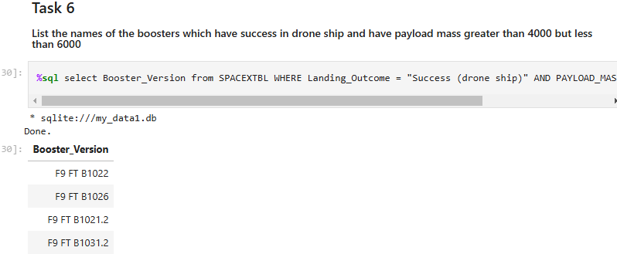
Successful Drone Ship Landing with Payload between 4000 and 6000
List of the Boosters which have successful drone shipping with payload mass greater than 4000 but less than 6000

Slide 29
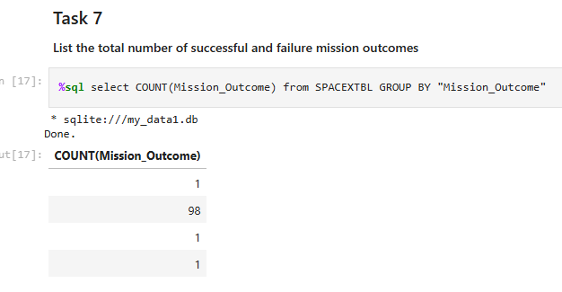
Total Number of Successful and Failure Mission Outcomes
List of Mission Outcome with total number of successful and failure missions

Slide 30
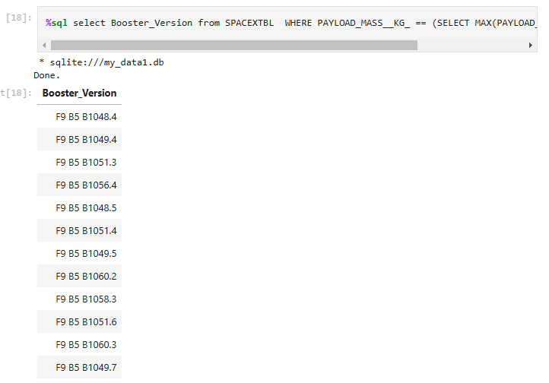
Boosters Carried Maximum Payload
List of Booster Versions that carried Maximum Payload

Slide 31
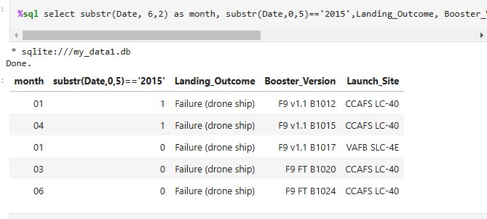
2015 Launch Records
Record of 2015 Landing outcome of 5 different Booster_Version from CCAFS LC-40 and VAFB SLC-4E lunch site

Slide 32

Section 3

Slide 33
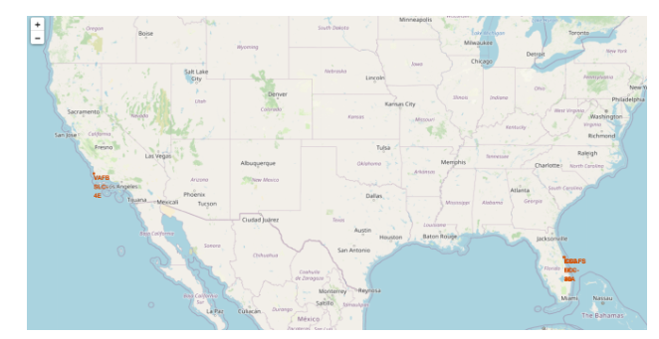
Folium Map Screenshot 1

Slide 34
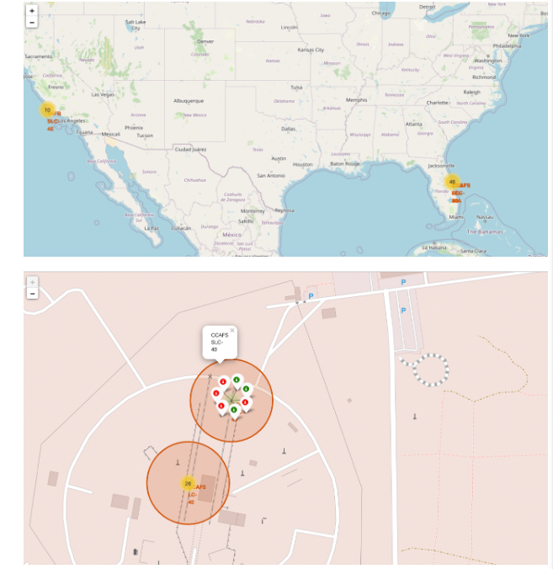
Folium Map Screenshot 2

Slide 35
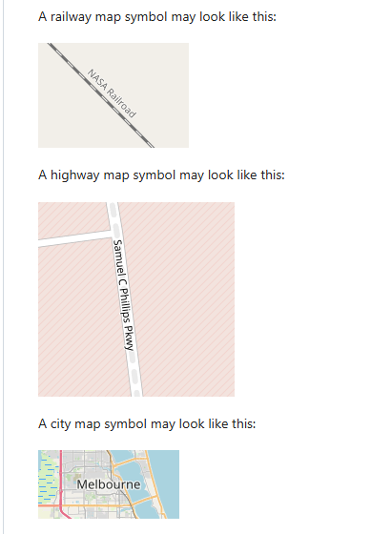
<Folium Map Screenshot 3>

Slide 36

Section 4

Slide 37
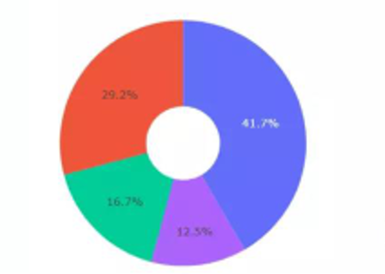
Dashboard Screenshot :Total Success Lunches by all sites
Blue: KSC LC-39A
Red: CCAFS LC-40
Green: VAF5 SLC-4E
Purple: CCAF5 SLC40
KSC LC-39A showed the most successful launches in all sites.

Slide 38
<Dashboard Screenshot 2>

Slide 39
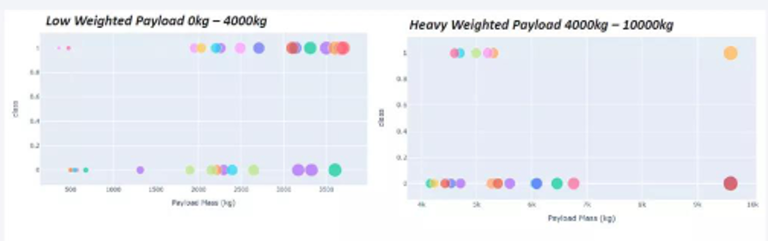
<Dashboard Screenshot 3>
Success rate for lower weighted payloads are higher than that of the heavier ones.

Slide 40

Section 5

Slide 41
Classification Accuracy

Slide 42
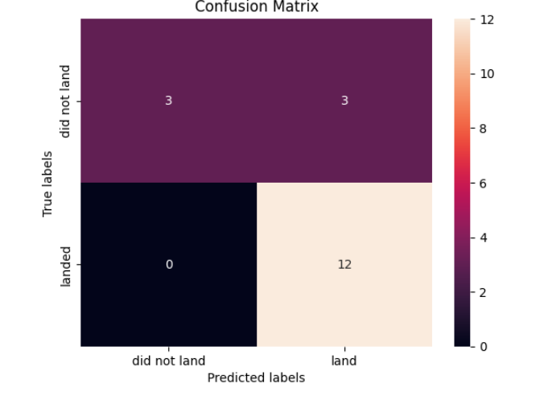
Confusion Matrix
Observations:
The confusion matrix indicates a very high True Positive rate of 12, demonstrating that the model accurately predicted all successful landings.​
There is no False Positive, suggesting that there were no incorrect predictions of landings when they did not occur.​
However, the model faced a False Negative issue, where 3 instances that actually landed successfully were incorrectly predicted not to land. This highlights a critical area for improvement in the model’s predictive accuracy.​
The True Negative count is 3, which is consistent across the other models, indicating reliable performance in identifying unsuccessful landings​

Slide 43
Conclusions
Visualization and SQL analysis revealed significant patterns in the data:​
KSC LC-39A boasts the highest overall success rate among all launch sites throughout the study period.​
CCAFS SLC 40 has the highest success rate for more recent launch attempts.​
The Falcon 9 first stage is more likely to land successfully when the payload mass ranges between 2,000 kg and 4,000 kg.​
Booster Version FT shows a higher likelihood of successful landings.​
For the orbit type 'SO', the Falcon 9 first stage has never achieved a successful landing.​
Model Performance:​
The Decision Tree model emerged as the most accurate predictor for whether the Falcon 9 first stage will land successfully, achieving an accuracy score of 0.85.​
General Observations:​
SpaceX data is highly accessible, providing ample details for in-depth analysis.​
Most successful missions had payloads ranging between 2,000 kg and 6,000 kg.​
All analyzed launch sites are strategically located at a safe distance from major urban areas.​
The Falcon 9 missions demonstrate a strong track record of success, regardless of payload mass, orbit type, or landing site—including drone ships in the ocean.​
The reusability of the Falcon 9 significantly reduces costs compared to competitors, coupled with its high success rate, bolstering SpaceX’s competitive position.​
In summary, considering the analyzed data, successful mission characteristics, and model performance, we confidently conclude that the Falcon 9 rocket will land successfully again in future missions.​​

Slide 44


